Slide 1
Introduction to Computational Thermodynamics
Section 2.3
Cubic equations of state

Slide 2
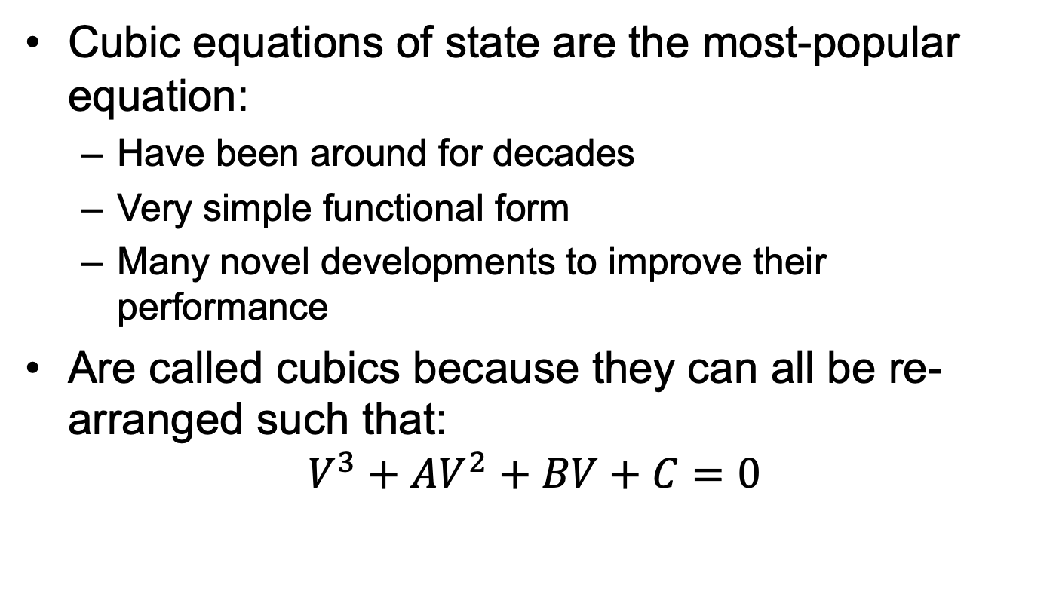
Introduction
Cubic equations of state are the most-popular equation:
Have been around for decades
Very simple functional form
Many novel developments to improve their performance
Are called cubics because they can all be re-arranged such that:
$$V^{3}+AV^{2}+BV+C=0$$

Slide 3
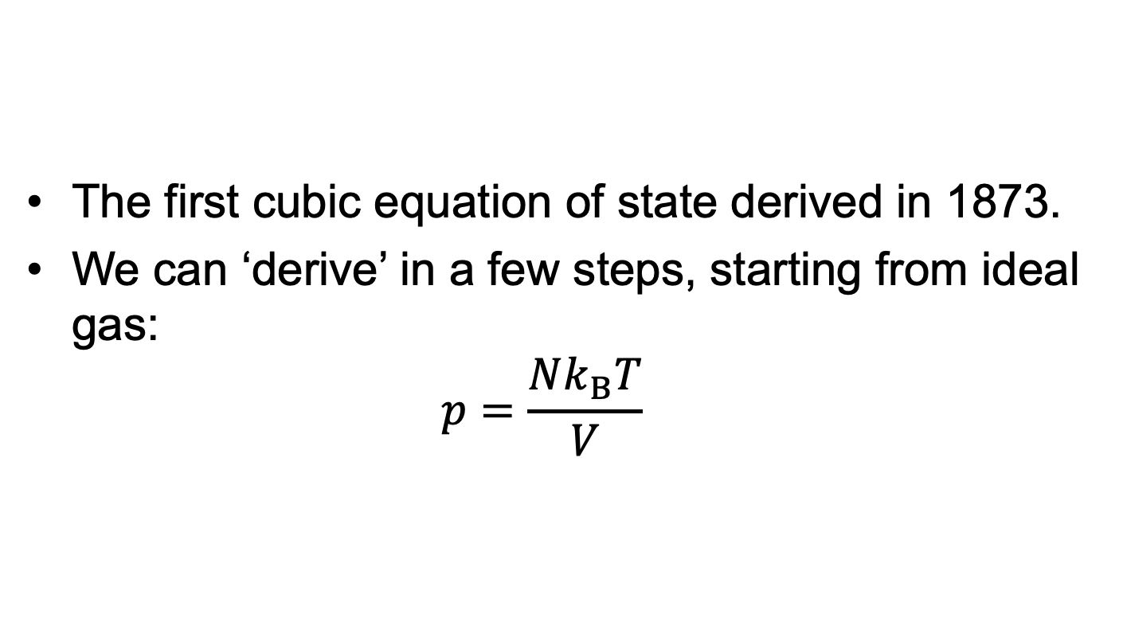
Van der Waals Equation
The first cubic equation of state derived in 1873.
We can ‘derive’ in a few steps, starting from ideal gas: $p=\frac{Nk_{B}T}{V}$

Slide 4
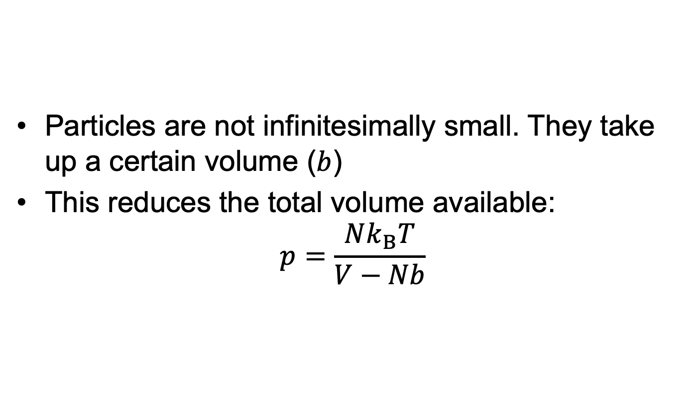
Van der Waals Equation
Particles are not infinitesimally small. They take up a certain volume ($b$)
This reduces the total volume available: $p=\frac{Nk_{B}T}{V−Nb}$

Slide 5
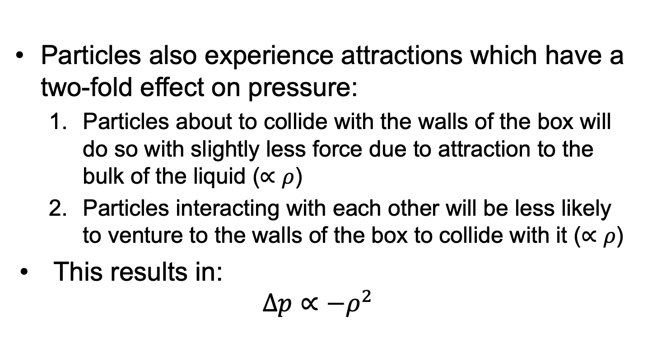
Van der Waals Equation
Particles also experience attractions which have a two-fold effect on pressure:
Particles about to collide with the walls of the box will do so with slightly less force due to attraction to the bulk of the liquid ($∝ρ$)
Particles interacting with each other will be less likely to venture to the walls of the box to collide with it ($∝ρ$)
This results in: $Δp∝−ρ^{2}$

Slide 6
Van der Waals Equation
Particles also experience attractions which have a two-fold effect on pressure:
Particles about to collide with the walls of the box will do so with slightly less force due to attraction to the bulk of the liquid ($∝ρ$)
Particles interacting with each other will be less likely to venture to the walls of the box to collide with it ($∝ρ$)
This results in: $Δp∝−ρ^{2}$

Slide 7
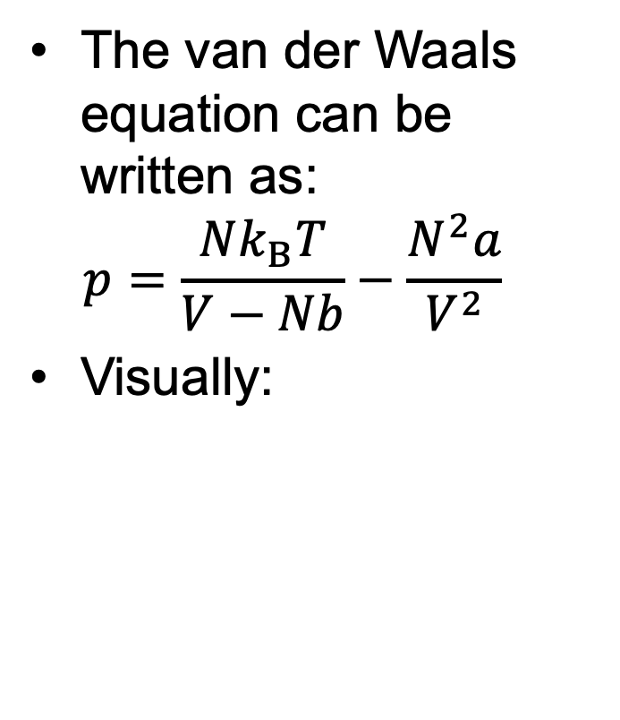
Van der Waals equation
The van der Waals equation can be written as: $p=\frac{Nk_{B}T}{V−Nb}−\frac{N^{2}a}{V^{2}}$
Visually:

Slide 8
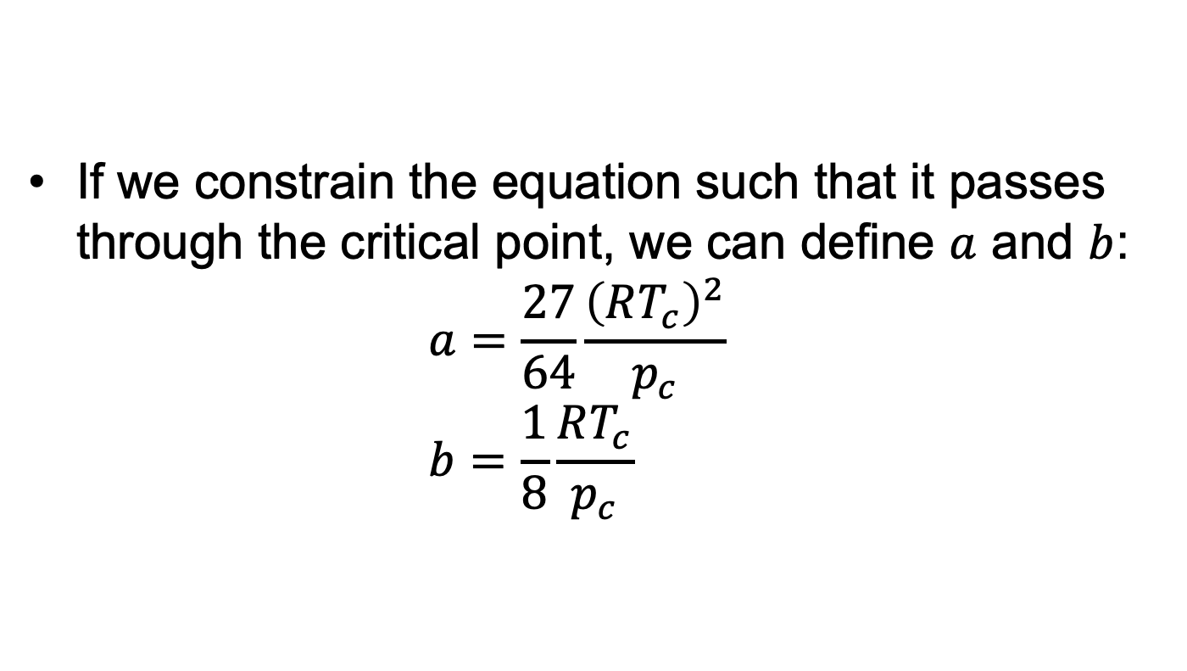
Van der Waals equation
If we constrain the equation such that it passes through the critical point, we can define $a$ and $b$: $a=\frac{27}{64}\frac{{\left(RT_{c}\right)}^{2}}{p_{c}}$ $b=\frac{1}{8}\frac{RT_{c}}{p_{c}}$

Slide 9
Van der Waals equation
Performs terribly:

Slide 10
Engineering equations of state
Trying to keep the simple functional form of the van der Waals equation, many researchers developed their own cubic equations of state.

Slide 11
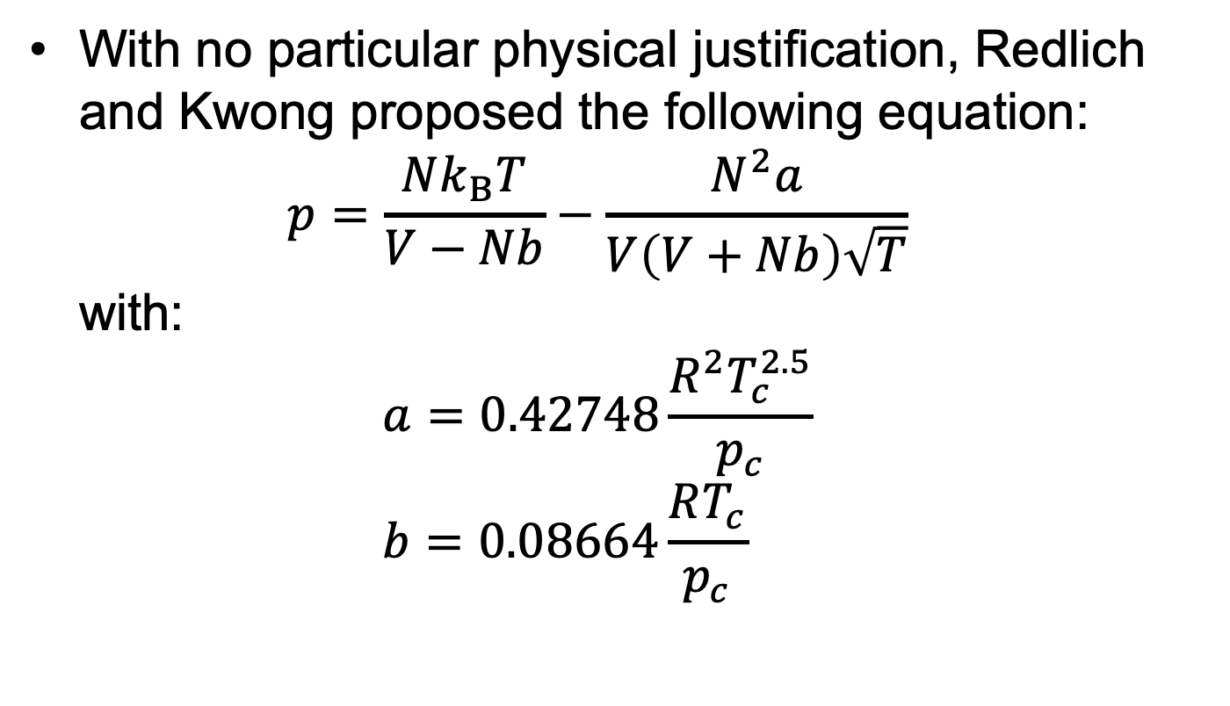
Redlich-Kwong equation
With no particular physical justification, Redlich and Kwong proposed the following equation: $p=\frac{Nk_{B}T}{V−Nb}−\frac{N^{2}a}{V\left(V+Nb\right)\sqrt{T}}$ with: $a=0.42748\frac{R^{2}T_{c}^{2.5}}{p_{c}}$ $b=0.08664\frac{RT_{c}}{p_{c}}$

Slide 12
Redlich-Kwong equation
Improvement over van der Waals:
Was intended to improve the modelling of gas fugacities.

Slide 13
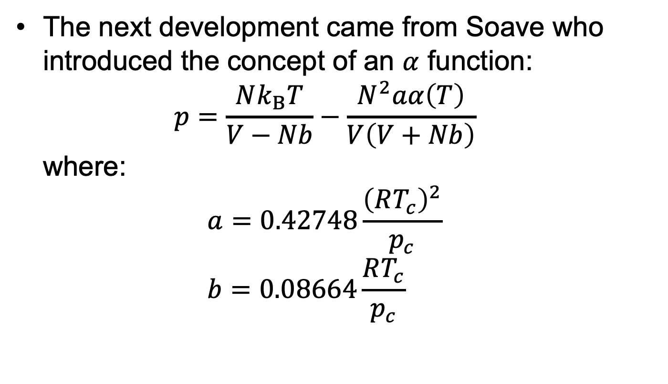
Soave-Redlich-Kwong equation
The next development came from Soave who introduced the concept of an $α$ function: $p=\frac{Nk_{B}T}{V−Nb}−\frac{N^{2}aα\left(T\right)}{V\left(V+Nb\right)}$ where: $a=0.42748\frac{{\left(RT_{c}\right)}^{2}}{p_{c}}$ $b=0.08664\frac{RT_{c}}{p_{c}}$

Slide 14
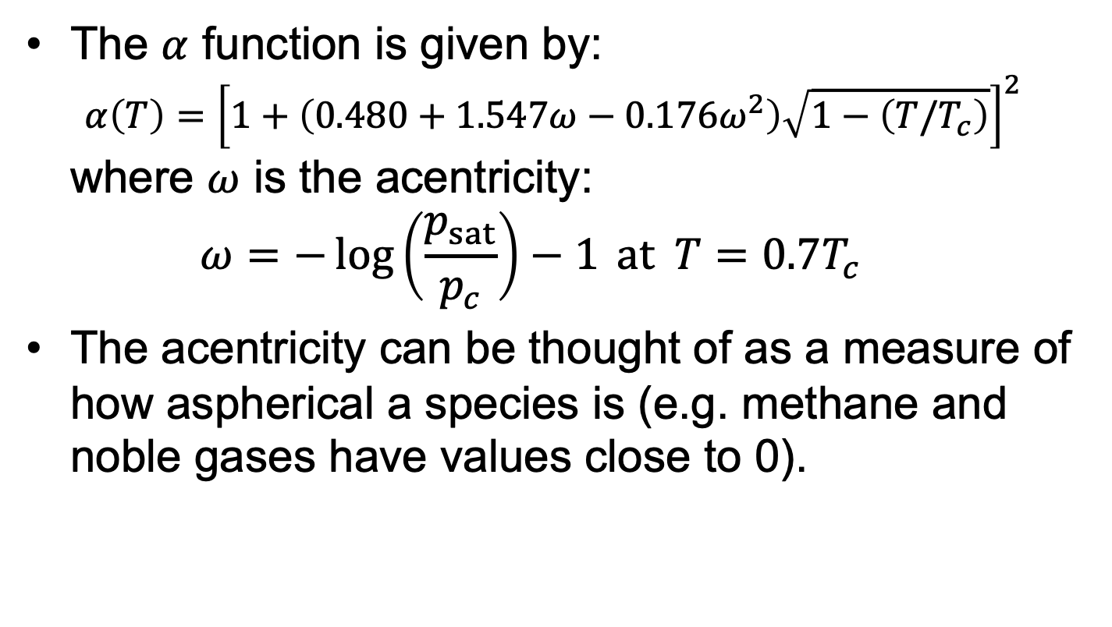
Soave-Redlich-Kwong equation
The $α$ function is given by: $α\left(T\right)={\left[1+\left(0.480+1.547ω−0.176ω^{2}\right)\sqrt{1−\left(T/T_{c}\right)}\right]}^{2}$ where $ω$ is the acentricity: $ω=−\log\left(\frac{p_{sat}}{p_{c}}\right)−1 at T=0.7T_{c}$
The acentricity can be thought of as a measure of how aspherical a species is (e.g. methane and noble gases have values close to 0).

Slide 15
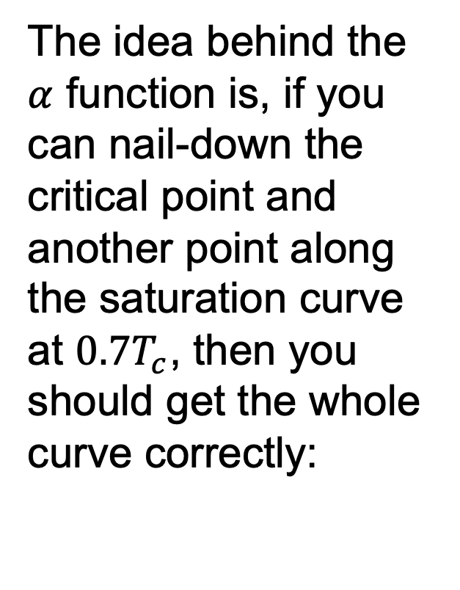
Soave-Redlich-Kwong equation
The idea behind the $α$ function is, if you can nail-down the critical point and another point along the saturation curve at $0.7T_{c}$, then you should get the whole curve correctly:

Slide 16
Soave-Redlich-Kwong equation
In some cases, it improved the modelling the densities as well:

Slide 17
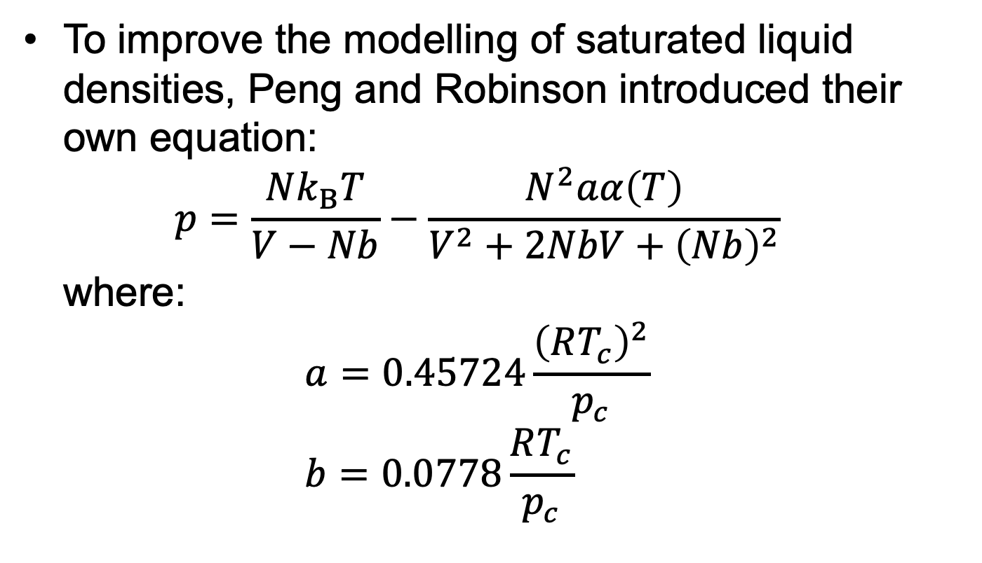
Peng-Robinson equation
To improve the modelling of saturated liquid densities, Peng and Robinson introduced their own equation: $p=\frac{Nk_{B}T}{V−Nb}−\frac{N^{2}aα\left(T\right)}{V^{2}+2NbV+{\left(Nb\right)}^{2}}$ where: $a=0.45724\frac{{\left(RT_{c}\right)}^{2}}{p_{c}}$ $b=0.0778\frac{RT_{c}}{p_{c}}$

Slide 18

Peng-Robinson equation
The $α$ function was also modified: $α\left(T\right)={\left[1+\left(0.37464+1.54226ω−0.26992ω^{2}\right)\sqrt{1−\left(T/T_{c}\right)}\right]}^{2}$

Slide 19
Peng-Robinson equation
These modifications did indeed improve the modelling of liquid densities:

Slide 20
Peng-Robinson equation
Both SRK and PR represent the industry standard for cubic equations of state.
They are only intended for hydrocarbon systems.
Can’t model hydrogen-bonding systems very accurately.

Slide 21
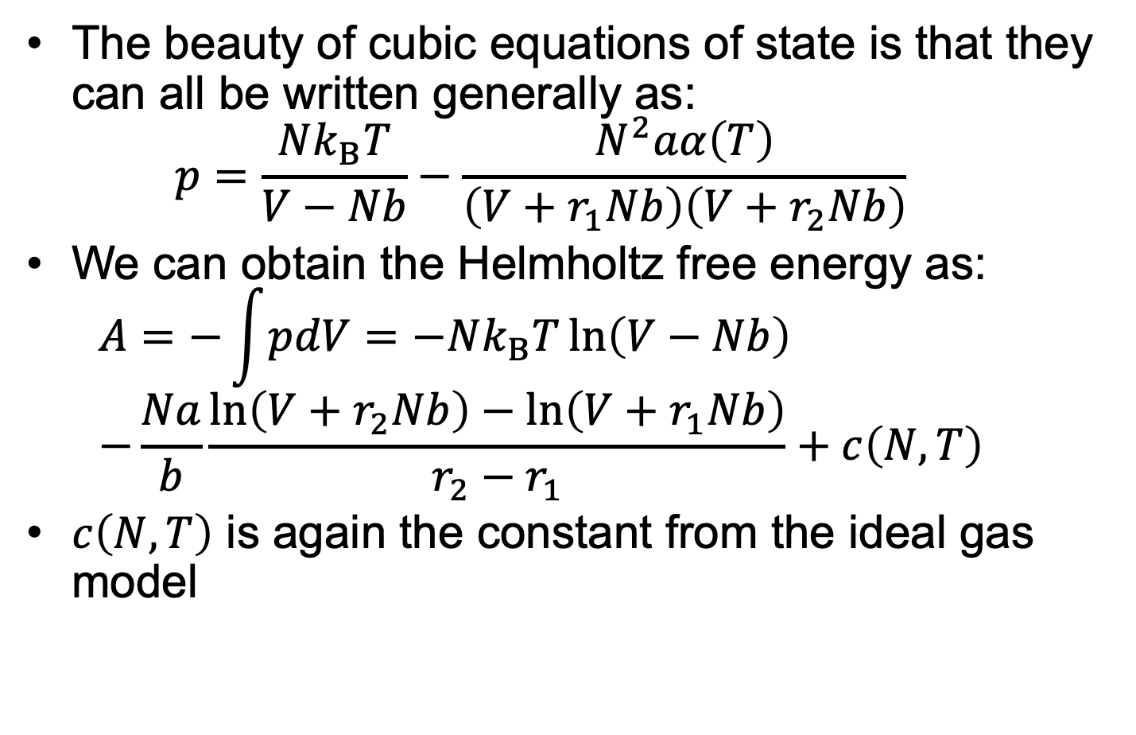
Implementation
The beauty of cubic equations of state is that they can all be written generally as: $p=\frac{Nk_{B}T}{V−Nb}−\frac{N^{2}aα\left(T\right)}{\left(V+r_{1}Nb\right)\left(V+r_{2}Nb\right)}$
We can obtain the Helmholtz free energy as: $A=−\int{pdV}=−Nk_{B}T\ln\left(V−Nb\right)$ $−\frac{Na}{b}\frac{\ln\left(V+r_{2}Nb\right)−\ln\left(V+r_{1}Nb\right)}{r_{2}−r_{1}}+c\left(N,T\right)$
$c\left(N,T\right)$ is again the constant from the ideal gas model

Slide 22
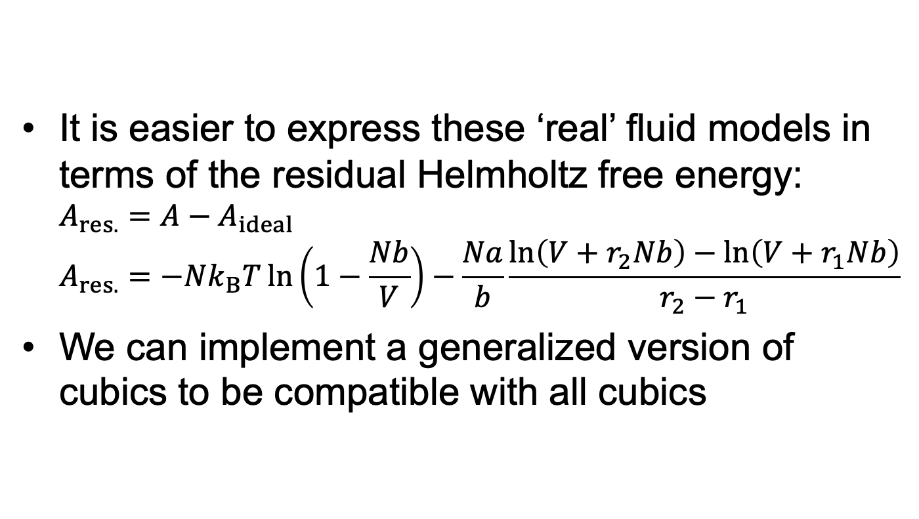
Implementation
It is easier to express these ‘real’ fluid models in terms of the residual Helmholtz free energy: $A_{res.}=A−A_{ideal}$ $A_{res.}=−Nk_{B}T\ln\left(1−\frac{Nb}{V}\right)−\frac{Na}{b}\frac{\ln\left(V+r_{2}Nb\right)−\ln\left(V+r_{1}Nb\right)}{r_{2}−r_{1}}$
We can implement a generalized version of cubics to be compatible with all cubics

Slide 23
Task
Switch to notebook and show “live” implementation

Slide 24
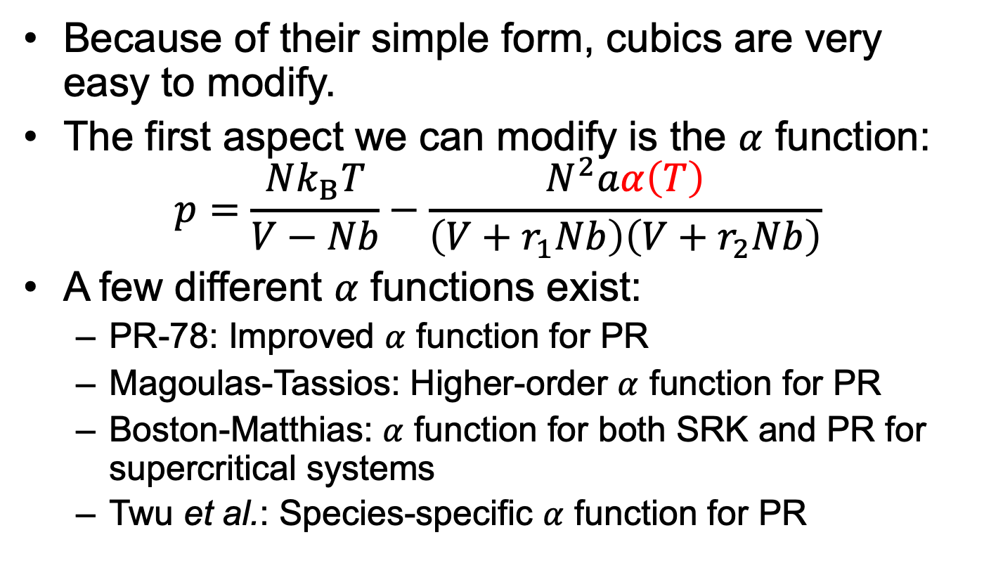

$α$ functions
Because of their simple form, cubics are very easy to modify.
The first aspect we can modify is the $α$ function: $p=\frac{Nk_{B}T}{V−Nb}−\frac{N^{2}aα\left(T\right)}{\left(V+r_{1}Nb\right)\left(V+r_{2}Nb\right)}$
A few different $α$ functions exist:
PR-78: Improved $α$ function for PR
Magoulas-Tassios: Higher-order $α$ function for PR
Boston-Matthias: $α$ function for both SRK and PR for supercritical systems
Twu et al.: Species-specific $α$ function for PR

Slide 25

$α$ functions
Species-specific $α$ functions can improve the modelling of pure-components:

Slide 26

$α$ functions
The effects of the $α$ function ripples into multi-component equilibrium:

Slide 27
$α$ functions
Even when one component is supercritical:

Slide 28

Volume translation
Unfortunately, $α$ functions do not improve the modelling of volumetric properties:

Slide 29
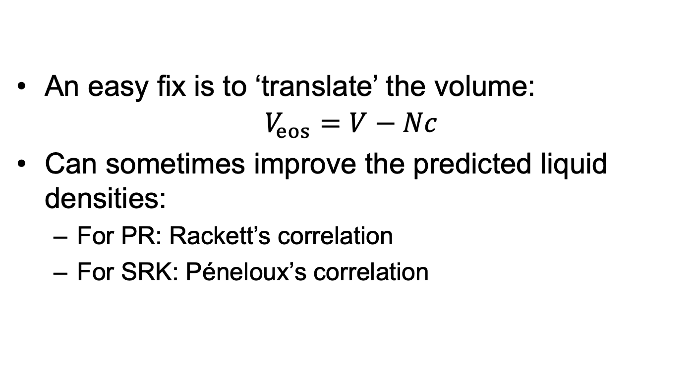
Volume translation
An easy fix is to ‘translate’ the volume:
$$V_{eos}=V−Nc$$
Can sometimes improve the predicted liquid densities:
For PR: Rackett’s correlation
For SRK: Péneloux’s correlation

Slide 30
Volume translation
Improvement is not always guaranteed:
Only need to use it when volumetric properties are important

Slide 31
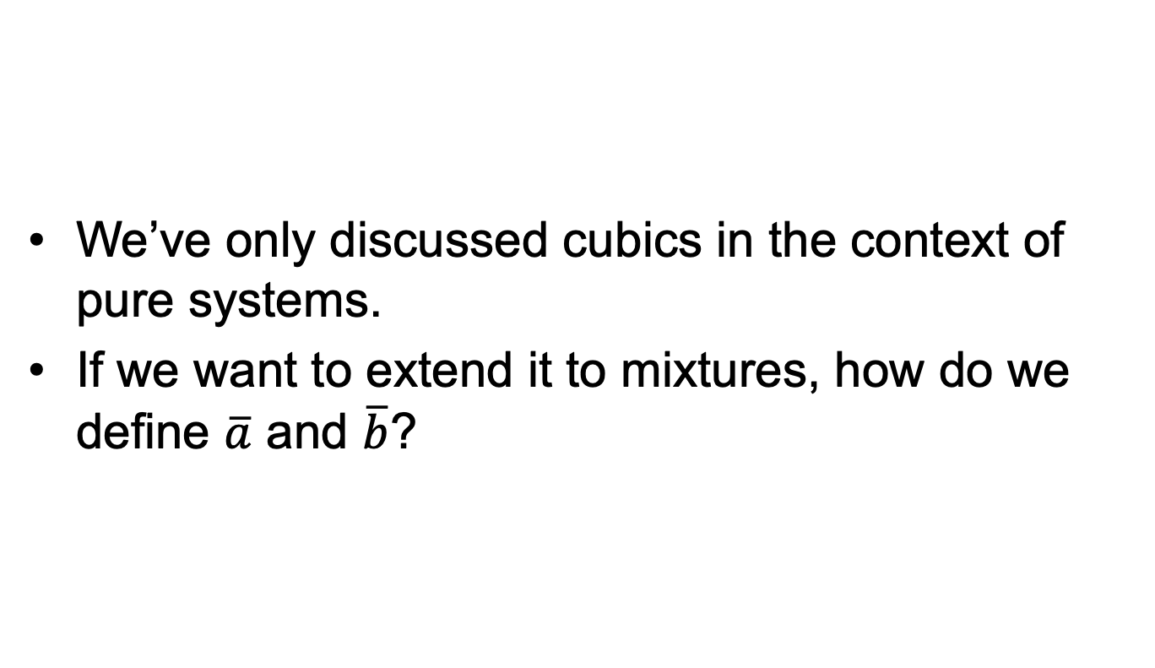
Mixing rules
We’ve only discussed cubics in the context of pure systems.
If we want to extend it to mixtures, how do we define $\overline{a}$ and $\overline{b}$?

Slide 32
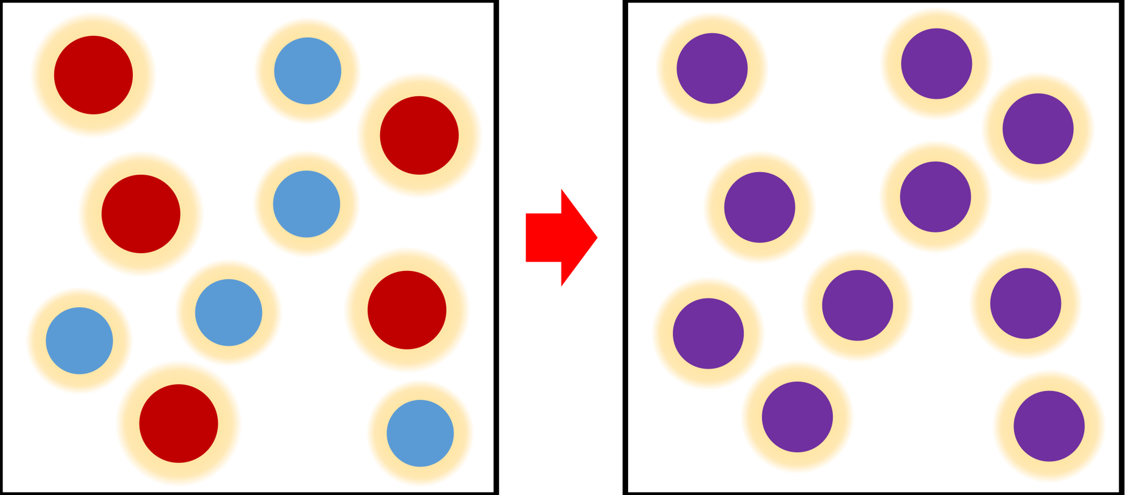
Mixing rules
We use mixing rules to model mixtures as “one-fluid”:

Slide 33
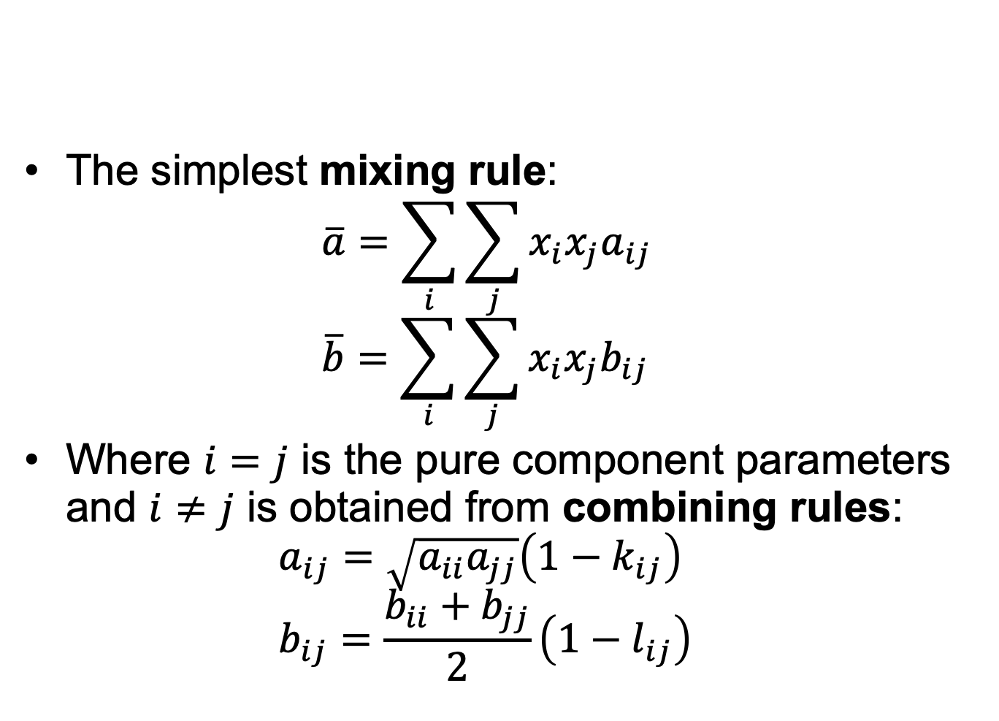
Van der Waals one-fluid
The simplest mixing rule: $\overline{a}=\sum_{i}{\sum_{j}{x_{i}x_{j}a_{ij}}}$ $\overline{b}=\sum_{i}{\sum_{j}{x_{i}x_{j}b_{ij}}}$
Where $i=j$ is the pure component parameters and $i≠j$ is obtained from combining rules: $a_{ij}=\sqrt{a_{ii}a_{jj}}\left(1−k_{ij}\right)$ $b_{ij}=\frac{b_{ii}+b_{jj}}{2}\left(1−l_{ij}\right)$

Slide 34
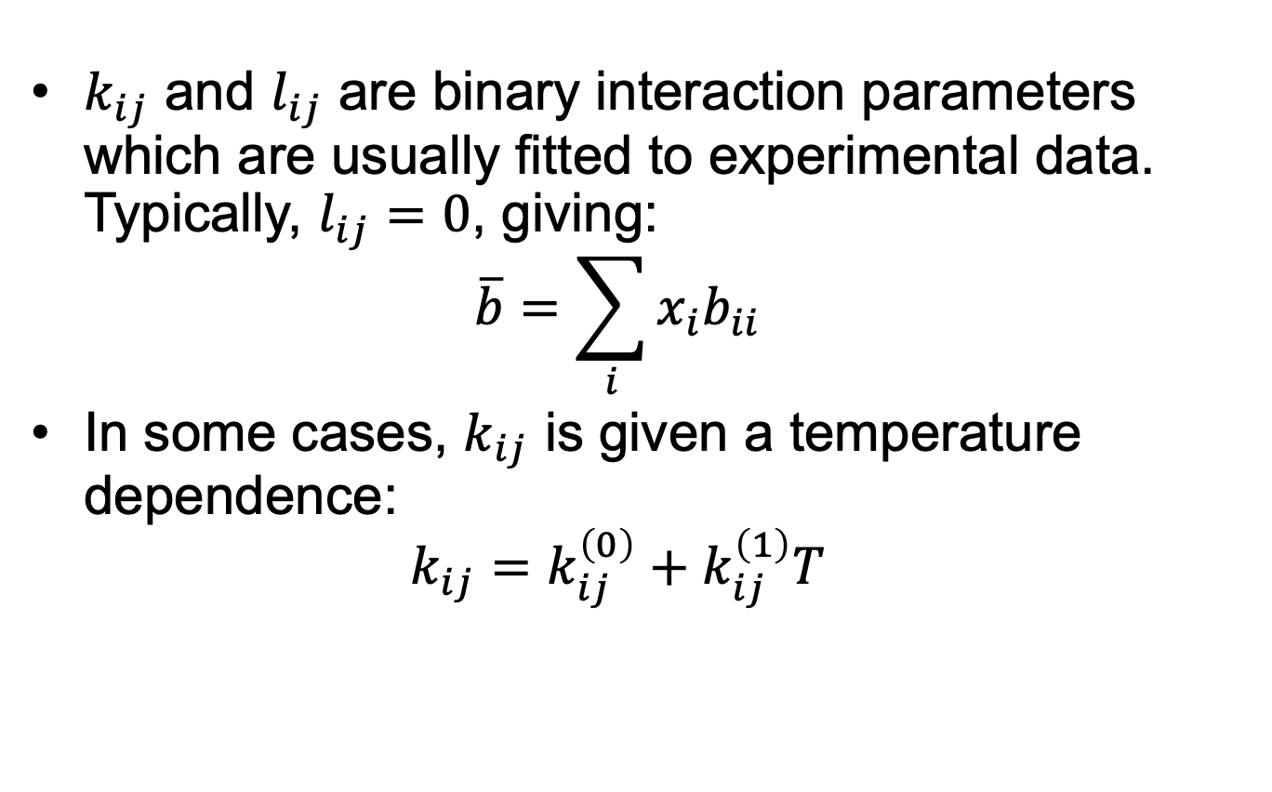
Van der Waals one-fluid
$k_{ij}$ and $l_{ij}$ are binary interaction parameters which are usually fitted to experimental data. Typically, $l_{ij}=0$, giving: $\overline{b}=\sum_{i}{x_{i}b_{ii}}$
In some cases, $k_{ij}$ is given a temperature dependence: $k_{ij}=k_{ij}^{\left(0\right)}+k_{ij}^{\left(1\right)}T$

Slide 35

Van der Waals one-fluid
$k_{ij}$ can become very important when predicting multi-component equilibrium properties:

Slide 36
Van der Waals one-fluid
Other mixing rules do exist (Kay’s rule, Rao’s rule, etc.)
All require binary interaction parameters to be useful
ASPEN and gPROMS contain databases of these parameters
Still are limited to systems with available experimental data

Slide 37
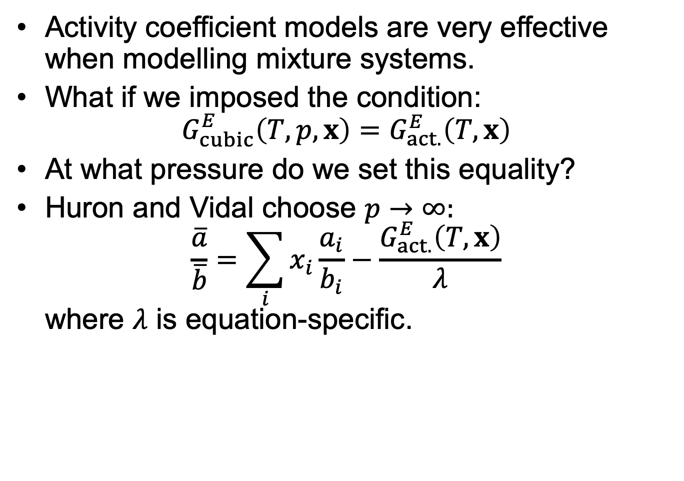

EoS/$G^{E}$ mixing rules
Activity coefficient models are very effective when modelling mixture systems.
What if we imposed the condition: $G_{cubic}^{E}\left(T,p,x\right)=G_{act.}^{E}\left(T,x\right)$
At what pressure do we set this equality?
Huron and Vidal choose $p→∞:$ $\frac{\overline{a}}{\overline{b}}=\sum_{i}{x_{i}\frac{a_{i}}{b_{i}}}−\frac{G_{act.}^{E}\left(T,x\right)}{λ}$ where $λ$ is equation-specific.

Slide 38
EoS/$G^{E}$ mixing rules
Other similar methods exist (e.g. Michelsen, and Wong and Sandler’s mixing rule).
When combined with UNIFAC, gives a predictive mixing rule!

Slide 39
EoS/$G^{E}$ mixing rules
Results in very accurate predictions:

Slide 40
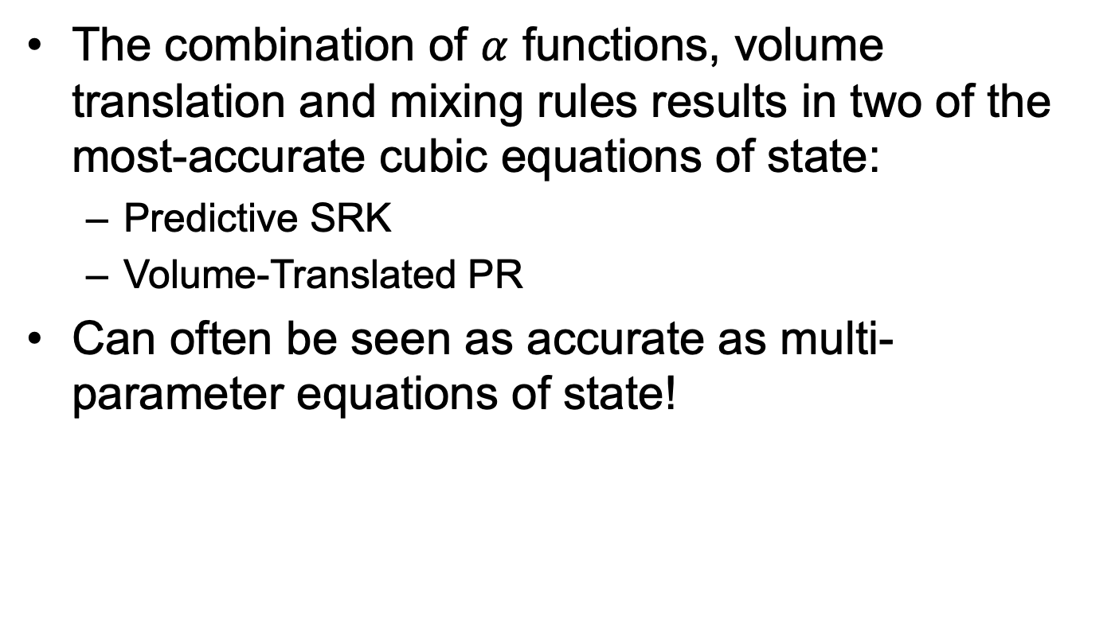
Predictive Cubics
The combination of $α$ functions, volume translation and mixing rules results in two of the most-accurate cubic equations of state:
Predictive SRK
Volume-Translated PR
Can often be seen as accurate as multi-parameter equations of state!
Switch to notebook and show “live” implementation

Slide 41
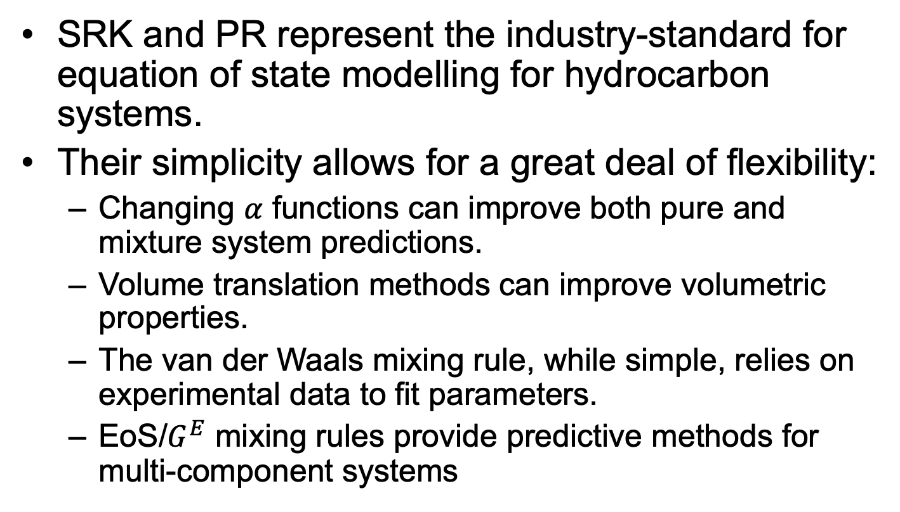
Key Points
SRK and PR represent the industry-standard for equation of state modelling for hydrocarbon systems.
Their simplicity allows for a great deal of flexibility:
Changing $α$ functions can improve both pure and mixture system predictions.
Volume translation methods can improve volumetric properties.
The van der Waals mixing rule, while simple, relies on experimental data to fit parameters.
EoS/$G^{E}$ mixing rules provide predictive methods for multi-component systems

